Slide 1
Case Studies: Google, Facebook, Twitter, Instagram
Web and Social Network Analysis - 10

Slide 2
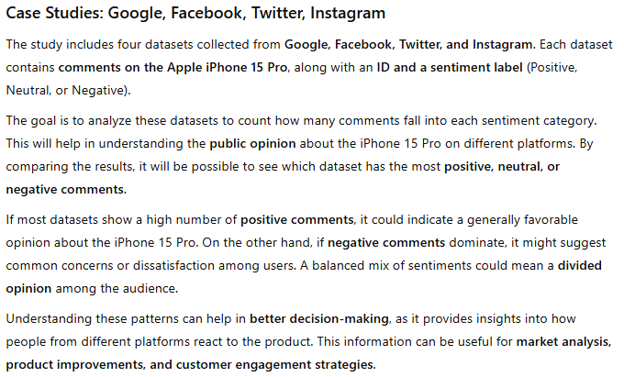

Slide 3

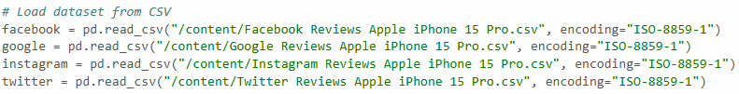



Slide 4




Slide 5
